Slide 1
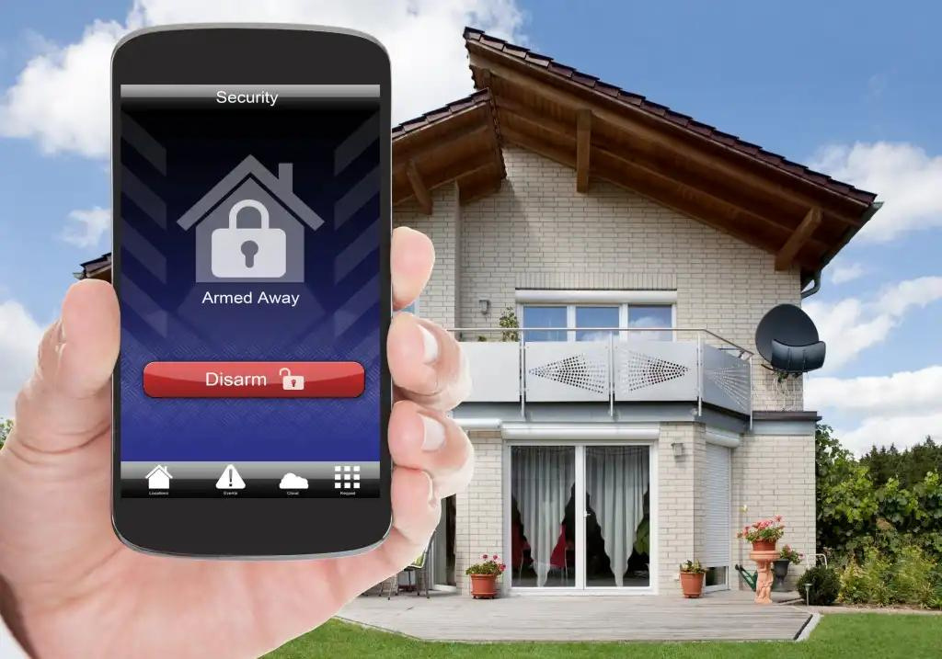


2023-054
SMART HOME ENVIRONMENT MONITORING AND INTELLIGENT ANTI-THEFT ALARMING SYSTEM

Slide 2



OVERVIEW
INTRODUCTION
SOLUTION
OBJECTIVES
SUB OBJECTIVES
OVERALL HIGH-LEVEL ARCHITECTURE DIAGRAM
METHODOLOGY
RESULTS & DISCUSSION
REFERENCES
Q & A

Slide 3


SUPERVISOR PANEL
SUPERVISOR
Mrs. Narmada Gamage
C0-SUPERVISOR
Mrs. Malmaleesha Poojani Gunathilaka

Slide 4




MEET THE TEAM
Leader
Sunil Gunasinghage R.W
M.M.S. Silva
J.S.P.A Ekanayake
Kodikara R.K.
IT20212704
CSNE
IT20383770
CSNE
IT20185534
CSNE
IT20182182
CSNE

Slide 5


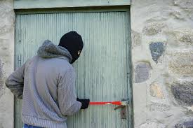
INTRODUCTION

Slide 6

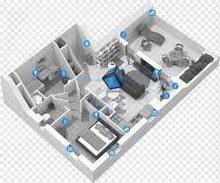
INTRODUCTION
Home security has become a major factor to be considered due to the rising rates of theft and burglary in modern society.
The Smart Home concept is the most recent solution invented to resolve such security problems in modern homes.
Anomaly detection is also a key concept in smart home systems where, unusual events are detected, and homeowners are alerted of these events
To better protect against threats and reduce false alarms, smart home concept needs to take a much more sophisticated and adaptive approach.

Slide 7

SOLUTION
To overcome these difficulties, Anomaly detection can be introduced.
Unusual events, such as strange sounds or movements, and deviations from what is expected can be detected using anomaly detection.
This cyber threat free ML powered system will monitor the behaviors & Voice patterns of the visitors as well as the Environment.

Slide 8
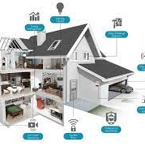

OBJECTIVES
MAIN OBJECTIVE
Create a cyber-threat free fully functioning smart home monitoring and an anti-theft system with enhanced physical security through behavior pattern and voice pattern monitoring and energy saving and protective plug bases.

Slide 9
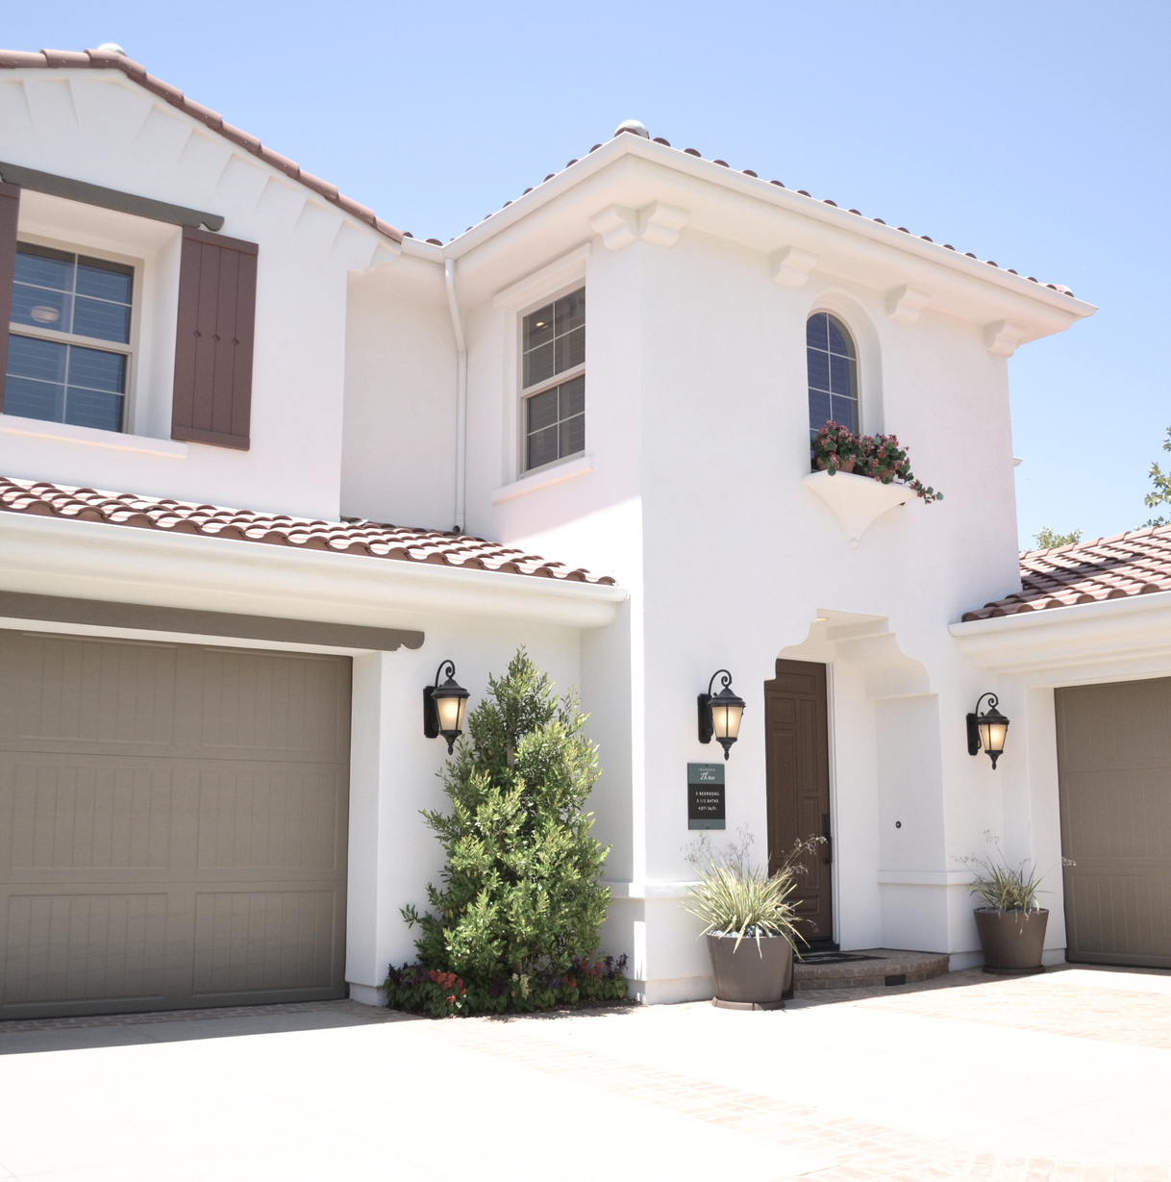
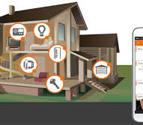
SUB OBJECTIVES
Enhance the physical security in a modern house by preventing intruder access.
Enhance the physical security in a modern house through anomaly(abnormal) voice detection.
Enable secure data communication in a modern house to enhance physical safety.
Enable an electric hazard-free environment in a modern house.

Slide 10
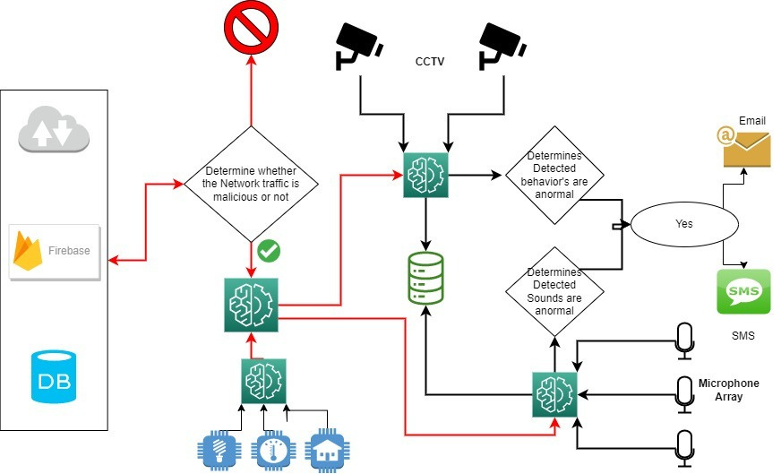
OVERALL HIGH-LEVEL ARCHITECTURE DIAGRAM

Slide 11

METHODOLOGY
The proposed mechanism and the components mainly consist of four sub systems
Abnormal Behavior Detection System
Abnormal Voice Detection System
Cyber Threat Detection System
Intelligent Plug Base

Slide 12
METHODOLOGY Cont.
Abnormal Behavior Detection System
Development Approach:
Combined AI technology with CCTV cameras.
Aimed to improve security and safety.
Data Collection:
Collected a wide range of CCTV footage representing normal and abnormal behaviors.
Removed any personal information to protect privacy.
Annotation and Labeling:
Footage annotated and labeled by the research team for normal and abnormal behaviors.
Ensured creation of a reliable dataset for training the AI model.
Model Building:
Utilized deep learning algorithms, specifically CNN.
Combined with frame capturing to build the AI model.
Training:
Trained the model using the labeled dataset.
Used pre-trained models to enhance performance.
Optimization:
Optimized for real-time performance.
Enabled quick processing of CCTV footage and prompt detection of abnormal behaviors.
Evaluation:
Evaluated based on accuracy, recall, precision, and F1-score.

Slide 13
METHODOLOGY Cont.
Abnormal Voice Detection System
Approach and Methodology:
Developed a system to detect abnormal voice patterns using Random Forest Classifier and microphone arrays.
Followed a step-by-step approach.
Data Collection:
Collected diverse voice recordings, capturing various accents, speech patterns, and noises.
Obtained necessary consents and respected privacy regulations.
Microphone Array System:
Used multiple strategically placed microphones for high-quality audio capture.
Preprocessing and Feature Extraction:
Improved voice recording quality by removing noise and normalizing volumes.
Extracted acoustic features like pitch, intensity, and spectral characteristics.
Model Training and Evaluation:
Optimized model parameters using techniques like cross-validation and grid search.
Split dataset into training, validation, and testing sets for evaluation.
Real-time Implementation:
Deployed the AI model in a system for real-time audio stream processing and optimized the system for low latency.

Slide 14
METHODOLOGY Cont.
Cyber Threat Detection System
Development Approach:
Utilized a step-by-step methodology.
Combined AI with blockchain technology for enhanced cyber threat detection in smart homes.
Data Collection and Preparation:
Collected datasets containing cyber threats, network traffic patterns, and security events.
Prepared data by cleaning, normalizing, and ensuring anonymity.
AI Model Development:
Developed a model using algorithms like Random Forest, Gaussian Naive Bayes, MLP.
Optimized and evaluated the model using various performance metrics.
Blockchain Implementation:
Implemented a blockchain-based framework for secure data communication.
Utilized cryptographic techniques for data confidentiality, integrity, and authenticity.
Integration:
Integrated the trained AI model with the blockchain framework.
Enabled real-time cyber threat detection and secure data communication within smart home networks.
Testing and Evaluation:
Conducted tests in simulated and real-world environments, assessing accuracy and scalability.

Slide 15
METHODOLOGY Cont.
Intelligent Plug Base
Design and Prototyping:
Designed for seamless incorporation of components like motion, fire, and oxygen detectors.
Developed necessary circuitry and hardware and created prototypes for testing.
Functionality Testing:
Conducted rigorous tests on each component for accurate readings and reliable performance.
Tested voice command functionality for accurate recognition and response.
Connectivity:
Implemented connectivity options such as Wi-Fi and Bluetooth.
Voice Command:
Incorporated voice recognition and natural language processing technologies.
Trained models with a diverse dataset for improved accuracy, considering various accents and languages.
Safety Monitoring:
Enabled real-time monitoring of various parameters like motion, smoke, fire, and oxygen levels.
Triggered immediate alerts and actions based on the detection of abnormal conditions.

Slide 16
RESULTS & DISCUSSION
Abnormal Behavior Detection System
This system can immediately detect, flag and notify homeowners of illegal violations.
It observes whether people perform unusual actions, such as relatively fast or slow movements, and if the person covers their face with an object.
Action recognition is achieved through frame capture, and masks can be recognized using a deep learning approach called Convolutional Neural Network (CNN).
The system efficiently stores nearest 10 seconds of abnormal activity evidence on a local hard drive.
The accuracy of this system is more than 90%.

Slide 17
RESULTS & DISCUSSION Cont.
Abnormal Voice Detection System
The system uses live microphone monitoring of sensitive environments to detect unusual sounds and notify homeowners via email and SMS, providing the source location.
The system used libraries such as Librosa and Numpy to create the sound recognition code and created the datasets manually.
Random Forest machine learning algorithm was used for this system.
The accuracy of this system is more than 85%.
This system is unique because no one has ever heard of such a system in homes.

Slide 18
RESULTS & DISCUSSION Cont.
Cyber Threat Detection System
The system effectively protects data privacy and integrity in the smart home ecosystem through machine learning algorithms, identifying unusual data patterns for potential security breaches.
The system was able to flag suspicious activity in real time, enabling quick responses to potential threats.
The trained AI model was integrated with the Blockchain Framework.
The k-nearest neighbors algorithm used for predict incoming network traffic.
The accuracy of this system is more than 90%.

Slide 19
RESULTS & DISCUSSION Cont.
Intelligent Plug Base
Through this system, if there is no movement around the plug base within a certain period or if a gas leak occurs around the plug base, it will be notified to the homeowner through the Smart Home Safety System.
And if any abnormality is detected in the voltage of the power supplied at the plug base, the Smart Home Safety System can monitor the decrease of the oxygen level.
Internet of Things (IoT), Arduino IDE and C++ programming language technologies have been used for this system.
This plug base provides protection to the homeowner.

Slide 20
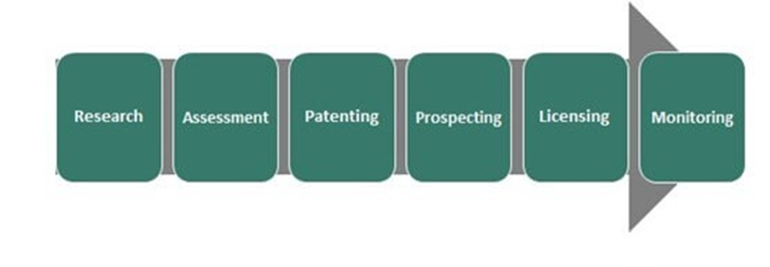
COMMERCIALIZATION

Slide 21
REFERENCE
[1] P. S. Y. Vaishnavi S. Gunge, "Smart Home Automation: A Literature Review," Computer Applications, pp. 06-10, 2016.
[2] J. Vanus, T. Novak, J. Koziorek, J. Konecny, and R. Hrbac, “The proposal model of energy savings of lighting systems in the smart home care,” IFAC proc. vol., vol. 46, no. 28, pp. 411–415, 2013.
[3]Researchgate.net.[Online].Available:https://www.researchgate.net/publication/251838675_The_development_of_smart_switch_system_for_the_automation_system_in_power_utilities. [Accessed: 18-Aug-2022].
[4] A Comprehensive Survey of IoT Security: Threats, Vulnerabilities, and Solutions" by S. Sicari et al.
[5] "Securing the Internet of Things: A Survey on Current Challenges and Solutions" by M. Al-Fuqaha et al.
[6] "Security and Privacy Challenges in the Internet of Things" by R. Roman et al.
[7] D. Kim, C. Hwang and T. Lee, "Stacked-autoencoder based anomaly detection with Industrial Control System," Software Engineering, Artificial Intelligence, Networking and Parallel/Distributed Computing, p. 191, 202
[8] Y. Sun, J. Yang and C.-H. Hsu, "Anomaly Detection for Smart Home Security Using Voice Recognition," IEEE Transactions on Industrial Informatics, vol. 15, no. 6, pp. 3218-3226, 2019
[9] A. Ghandeharioun and R. W. Picard, "Smart Home Security: Voice-Based Anomaly Detection and Intrusion Prevention," IEEE Transactions on Multimedia, vol. 19, no. 4, pp. 807-819, 2017.
.[10] B. D. Romaissa, O. Mourad and N. Brahim, "Vision-Based Multi-Modal Framework for Action Recognition," 2020 25th International Conference on Pattern Recognition (ICPR), Milan, Italy, 2021, pp. 5859-5866, doi: 10.1109/ICPR48806.2021.9412863.
[11] S. R. Rashmi, S. Bhat, and V. C. Sushmitha, "Evaluation of human action recognition techniques intended for video analytics," 2017 International Conference On Smart Technologies For Smart Nation (SmartTechCon), Bengaluru, India, 2017, pp. 357-362, doi: 10.1109/SmartTechCon.2017.8358396.
[12] A. M. F and S. Singh, "Computer Vision-based Survey on Human Activity Recognition System, Challenges and Applications," 2021 3rd International Conference on Signal Processing and Communication (ICPSC), Coimbatore, India, 2021, pp. 110-114, doi: 10.1109/ICSPC51351.2021.9451736.

Slide 22
THANK YOU!

